Slide 1
Sean Koppenhafer, Jaime Rodriguez,
Chad Thueson, Noah Erickson, Rishal Dass
Weekly meeting, 4/29/2015
Digital Dash
Portland State University
Department of Electrical and Computer Engineering (ECE)
Notes:
1
1

Slide 2
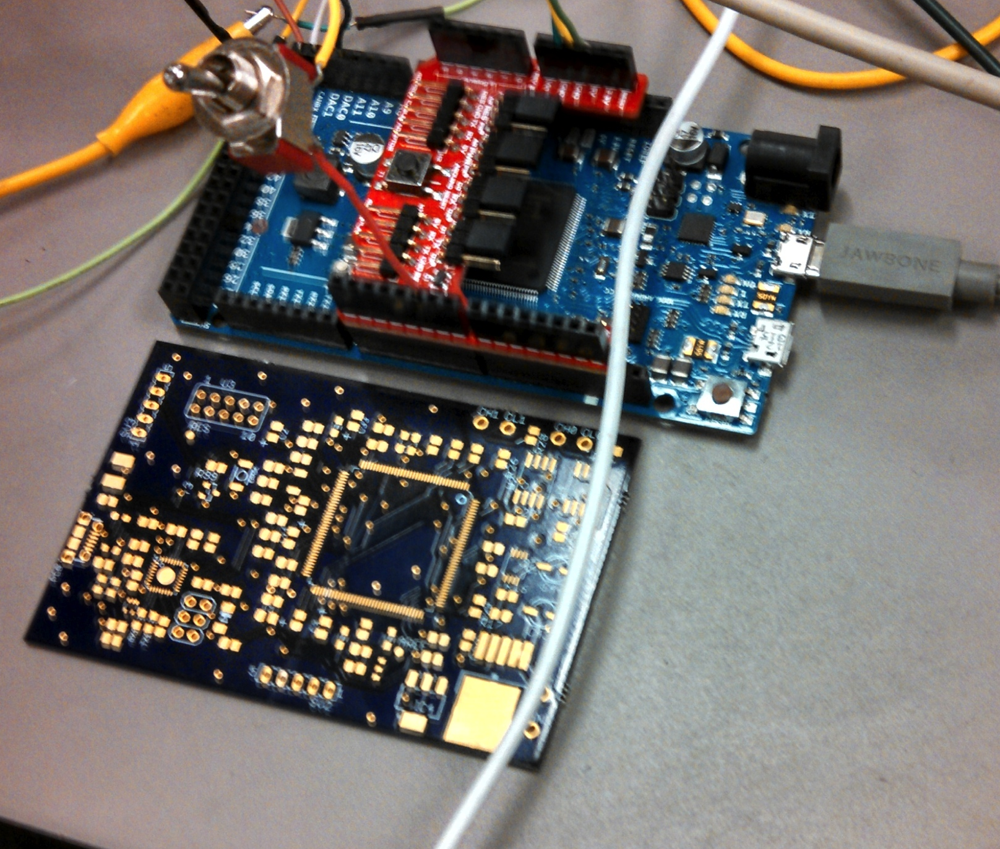
Final Design PCB
Final board has arrived
  Populated via reflow oven, 86 components
  ATMEGA16u2 hard to solder
  ATMEGA16u2 getting extremely hot when powered
  ATMEGA16u2 Used to program ATSAM3X, may need to get a bigger package for the u2 and use a breakout board to connect to our PCB
  If we cannot get the PCB working we will have to order another Arduino Due.
  One Due for the dash, one for the demo unit

Slide 3
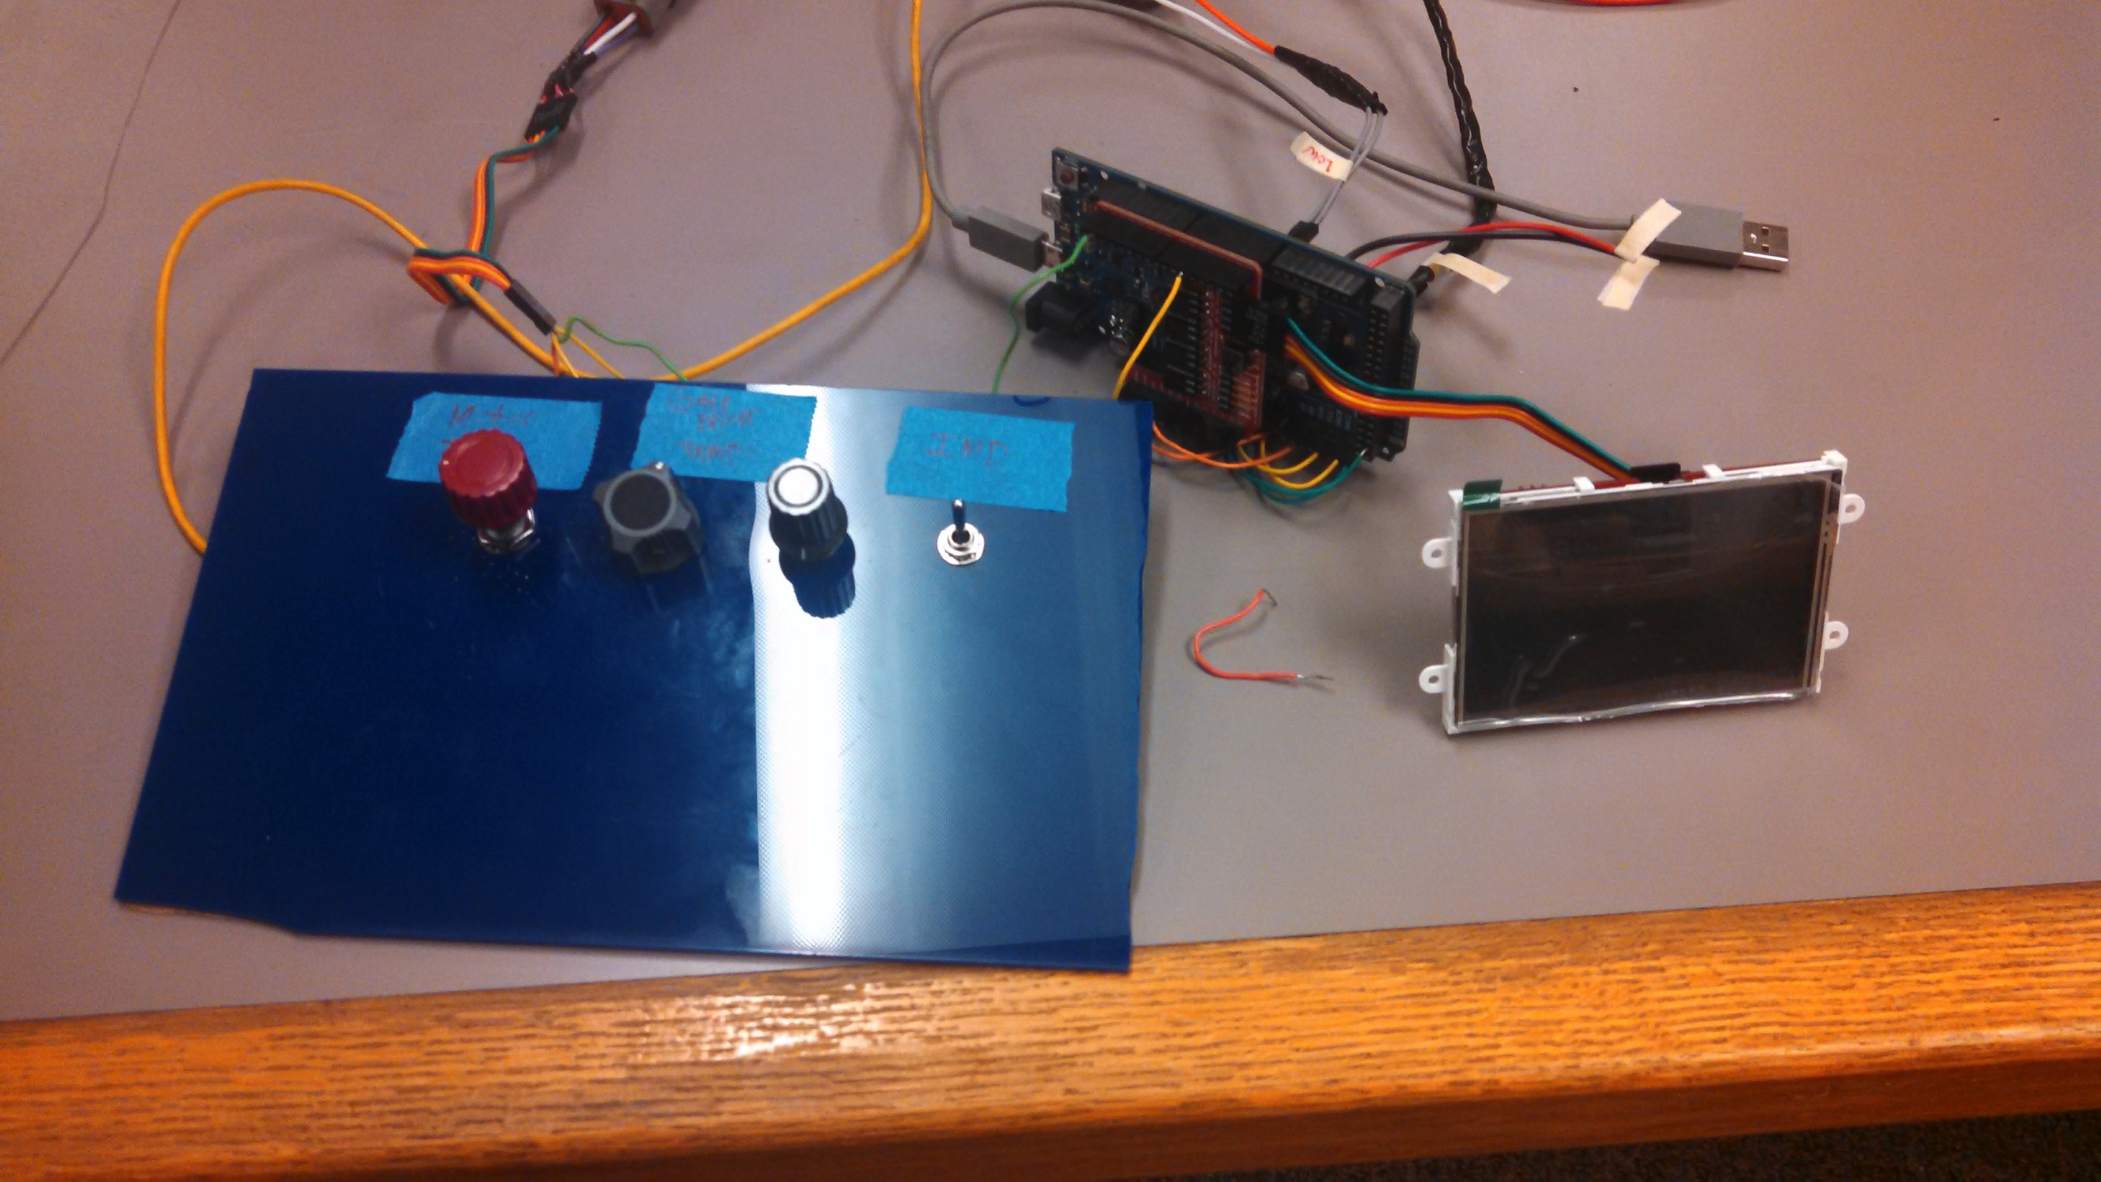
Demo Unit
Wrote test code that sends CAN messages based on input from switches and potentiometers
eVCU is now reading the potentiometers, analog inputs were reversed
Screen outputs potentiometer adjusted values for motor temp and switch for IMD
Still need to implement battery level potentiometer

Slide 4
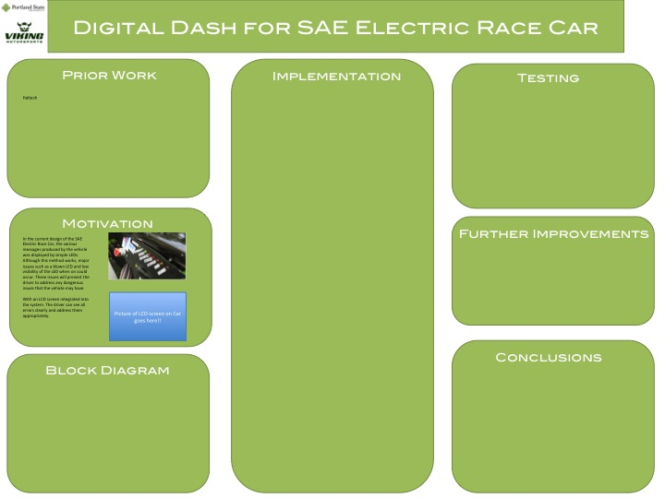
Report and Poster
Testing added to the final report
Team looked at various poster designs
Poster due on May 27
Poster template complete

Slide 5
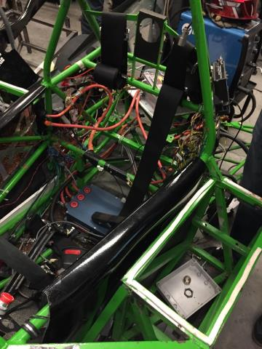
Electric Vehicle Update
In Progress
Car is still dismantled
New Frame is being completed
Motor mounted

Slide 6
Goals For The Upcoming Week
System
- Get demo unit working, battery level adjustment
- Troubleshoot the custom PCB, may have reflow specialist from Intel look at it?
Enclosure
- On hold until we decide on PCB vs Due
Documentation
- Keep working on report
- Keep working on poster
- Update wiki
Other
- Present progress to VMS on Friday, May 1st
Notes:
6

